Slide 1
Intro to Neural Networks and Deep Learning
(focusing on NLP classification)
Some slides are adopted from “ML for NLU” course of Sam Bowman (NYU) and “AI” course at UC Berekley

Slide 2
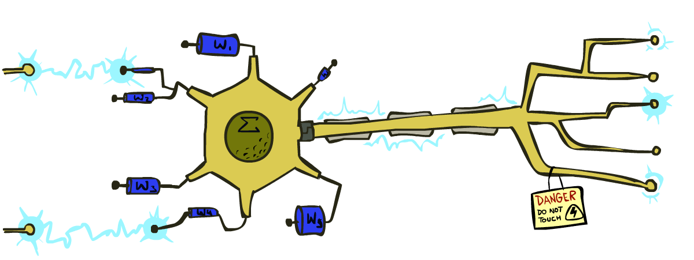
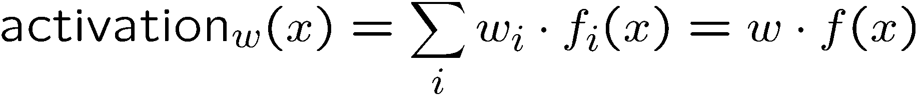
Linear Classifiers
Inputs are feature values
Each feature has a weight
Sum is the activation
If the activation is:
  Positive, output +1
  Negative, output -1
w₁
f₁
Σ
w₂
>0?
f₂
w₃
f₃

Slide 3
How to get probabilistic decisions?
Activation:
  If very positive → want probability going to 1
  If very negative → want probability going to 0
Sigmoid function

Slide 4
Best w?
Maximum likelihood estimation:
with:
= Logistic Regression

Slide 5

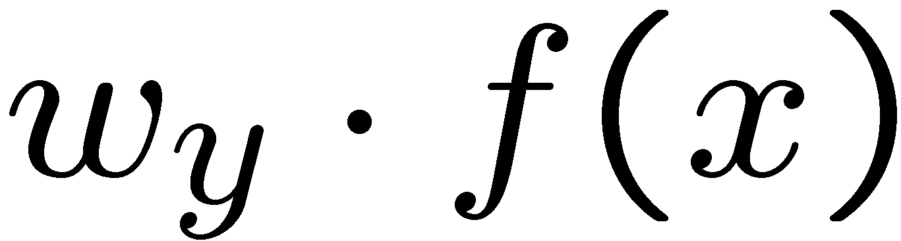
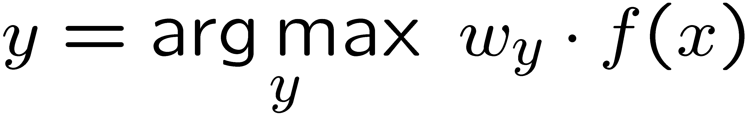
Multi-class Logistic Regression
Multi-class linear classification
  A weight vector for each class:
  Score (activation) of a class y:
  Prediction w/highest score wins:
How to make the scores into probabilities?
original activations
softmax activations

Slide 6
Multi-class Logistic Regression
= special case of neural network
f₁(x)
z₁
softmax
f₂(x)
z₂
f₃(x)
…
z₃
f_{K}(x)

Slide 7
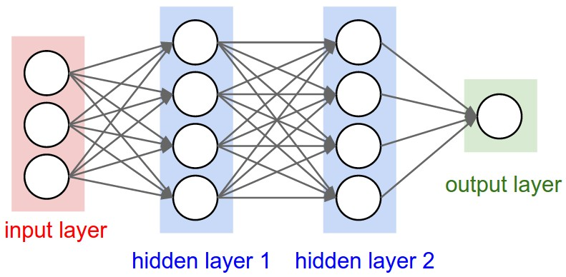
Nonlinear classifiers out of perceptrons
Build a multi-layer neural network!

Slide 8
Deep Neural Network = Also learn the features!
x₁
f₁(x)
softmax
x₂
f₂(x)
…
x₃
f₃(x)
…
…
…
…
…
x_{L}
f_{K}(x)
g = nonlinear activation function

Slide 9
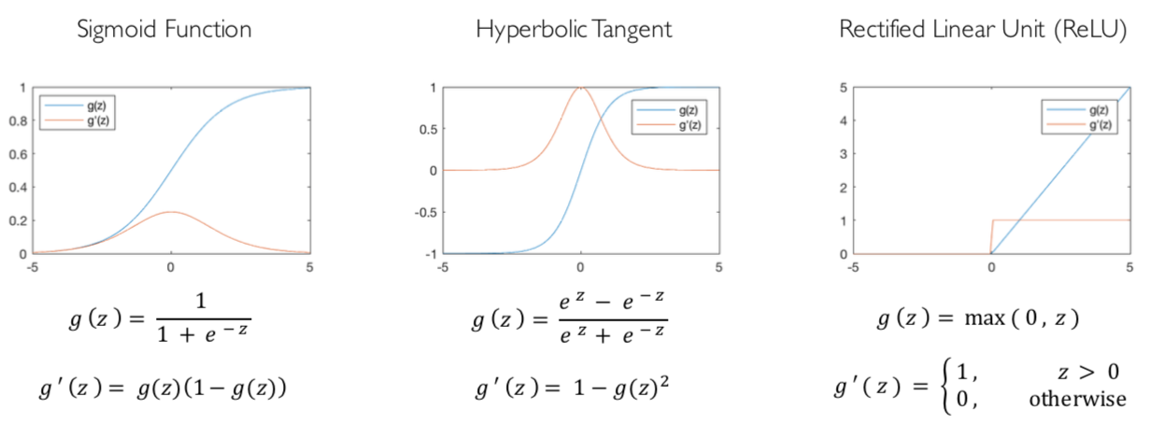
Common Activation Functions
[source: MIT 6.S191 introtodeeplearning.com]

Slide 10
Deep Neural Network: Training
Training the deep neural network:
Using gradient descent algorithm

Slide 11
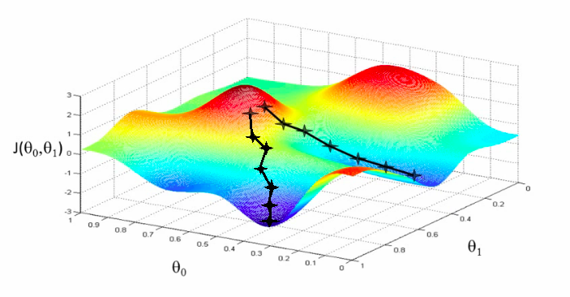
Deep Neural Network: Training
Update weights by gradient descent:
w₂
w₁

Slide 12
Deep Learning for Text Classification

Slide 13

Text classification example: sentiment analysis
Given a piece of text, predict the sentiment

Slide 14
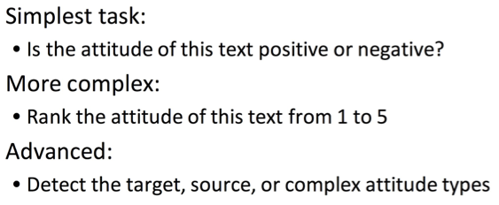
Sentiment analysis

Slide 15
Classification
Output a choice from a fixed set of labels
For sentiment:
  Positive/negative
  Star rating
  …

Slide 16
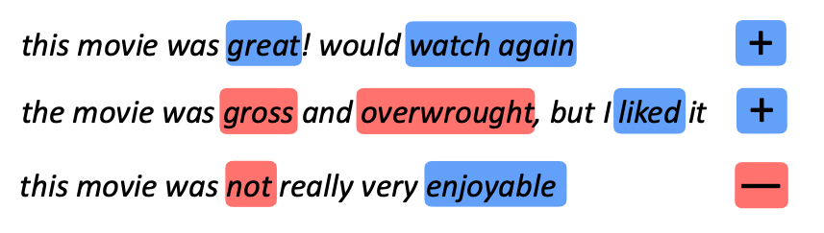
Some examples of binary sentiment classification
https://www.cs.utexas.edu/~gdurrett/courses/online-course/materials.html

Slide 17
Building a classifier
Let’s say we have 10k labeled sentences
We want to learn a function f that
  maps an unseen sentence to one of the labels

Slide 18
Classification with supervised learning
Collect some example input-label pairs (x,y)
Design a model that can map inputs to labels and whose behavior depends on the values of some parameters θ
Use a learning algorithm to train or fit the parameters θ to the input-label pairs (x,y)
  this usually involves optimization: picking parameters that perform best (according to some measure of performance) at predicting the labels from the inputs.

Slide 19
From strings to words
I don’t like any of Ford’s trucks.
I do n’t like any of Ford ‘s trucks .
Tokenization: Turning strings into a sequence of symbols (e.g., words, subwords, characters, etc)

Slide 20
Evaluating a Two-Class Classifier

Slide 21
Training supervised classifiers
We usually need to use regularization to avoid overfitting
  early stopping could be used as well
We split data into train, dev, test
Normally all subsets are from the same distribution
The hyperparameters of the models are chosen using the dev set

Slide 22
NN sentiment classifier

Slide 26
We'll build a new model of meaning focusing on similarity
Each word = a vector
Similar words are "nearby in space"

Slide 27
We define a word as a vector
Called an "embedding" because it's embedded into a space
The standard way to represent meaning in NLP
Fine-grained model of meaning for similarity
  NLP tasks like sentiment analysis
    With words, requires same word to be in training and test
    With embeddings: ok if similar words occurred!!!
  Question answering, conversational agents, etc

Slide 33
What are NNs made of?

Slide 35
From Bag-of-Words Networks to Convolutional Networks

Slide 36
Convolutional Networks

Slide 39
We will discuss attention more in the future

